Slide 1
Information Sources and Signals
COSC 350

Slide 2
Data Signals
Analog: characterized by continuous mathematical function.
Digital: has a fixed set of valid levels.
Periodic signals have repetitive patterns and aperiodic ones don’t

Slide 3
Sine Waves
Natural phenomena produce sine waves
Four main characteristics
Frequency
Amplitude
Phase: shifted amount of the start of sine wave from a reference time
Wavelength: length of a cycle as it propagates across a medium

Slide 4
Units of time and frequency
Time unit | Value | Frequency unit | Value
Seconds (s) | 10⁰sec | Hertz (Hz) | 10⁰Hz
Milliseconds (ms) | 10⁻³sec | KHz | 10³Hz
Microseconds (µs) | 10⁻⁶sec | MHz | 10⁶Hz
Nanoseconds (ns) | 10⁻⁹sec | GHz | 10⁹Hz
Picoseconds (ps) | 10⁻¹²sec | THz | 10¹²Hz

Slide 5
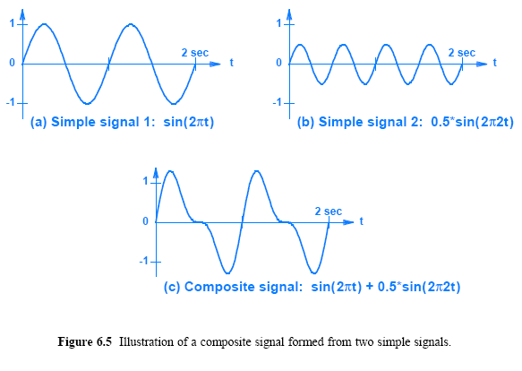
Composite Signals

Slide 6
The Importance of Composite Signals and Sine Functions
Utilized in data communication
Natural phenomena produce sine waves as a function of time
Modulation and demodulation
modulation produces composite signals
From Fourier, it is possible to decompose a composite signal into its constituent parts
if the composite signal is periodic, the constituent parts will also be periodic

Slide 7
Time and Frequency domain representations
A graph of a signal as a function of time is known as time domain representation
The other representation is known as a frequency domain
A composite function can be shown as a set of simple sine waves
The function A sin(2πt) is represented by a single line of height A that is positioned at x = t

Slide 8
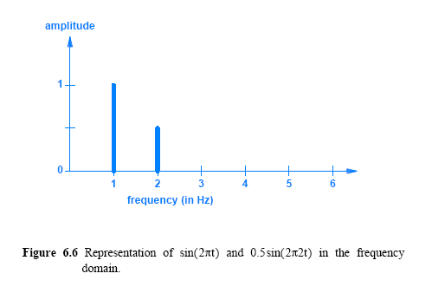
Frequency Domain

Slide 9
Time and Frequency Domain Representations
A frequency domain representation
useful with periodic signals
Compactness
both small and easy to read occupies only a single point along the x-axis
the advantage becomes clear when a composite signal contains many simple signals
Notes:
9

Slide 10
Bandwidth of an Analog Signal
the definition of bandwidth varies; one definition of analog bandwidth
the difference between the highest and lowest frequencies of the constituent parts
the highest and the lowest frequencies obtained by Fourier analysis
Notes:
10

Slide 11
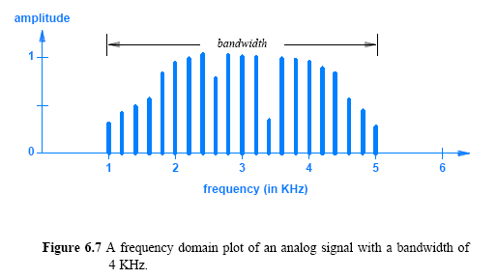
Bandwidth of an Analog Signal
Notes:
11

Slide 12
Digital Signals and Signal Levels
When voltage is used
positive: logical one
zero: logical zero
When two levels of voltage are used
each level corresponds to one data bit (0 or 1).
When multiple digital levels are available
each level can represent multiple bits
E.g. four levels of voltage:
-5 volts, -2 volts, +2 volts, and +5 volts
Notes:
12

Slide 13
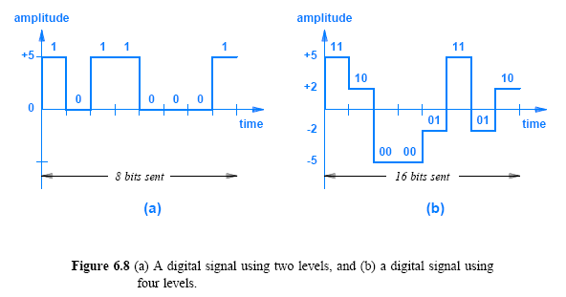
Digital Signals and Signal Levels
Notes:
13

Slide 14
Digital Signals and Signal Levels
For each possible combination of bits => one signal level
There are 2^{n} combinations (number of levels) possible with n bits
One could achieve arbitrary numbers of levels by dividing voltage into arbitrarily small increments
But the system may not distinguish between signals
Notes:
14

Slide 15
Baud and Bits Per Second
The rate at which data can be sent depends on
the number of signal levels
the amount of time the system remains at a given level before moving to the next
Figure 6.8a shows time along the x-axis, and the time is divided into eight segments
If the communication system is modified to use half as much time for a given bit
twice as many bits will be sent in the same amount of time
Notes:
15

Slide 16
Baud and Bits Per Second
A signal level must remain at a given level long enough to be detected
The accepted measure of a communication system does not specify a length of time
Baud: number of times that the signal changes per second
E.g. a signal remain at a given level for .001 seconds, the system is said to be operating at 1000 baud
Both baud and number of signal levels control bit rate
Notes:
16

Slide 17

Baud and Bits Per Second
A system with two signal levels operating at 1000 baud
Transfers 1000 bits per second
A system operating at 1000 baud with four signal levels
Transfers 2000 bits per second
The relationship between baud, signal levels, and bit rate
Notes:
17

Slide 18
Converting a Digital Signal to Analog
A composite of sine waves
Represented by arbitrary wave
Each sine wave in the set has a specific amplitude, frequency, and phase
Fourier's theorem
to a digital signal requires an infinite set of sine waves
Infinite bandwidth?
Engineers adopt a compromise:
conversion of a signal from digital to analog is approximate
generate analog waves that closely approximate the digital signal
approximation involves building a composite signal from only a few sine waves
Notes:
18

Slide 19
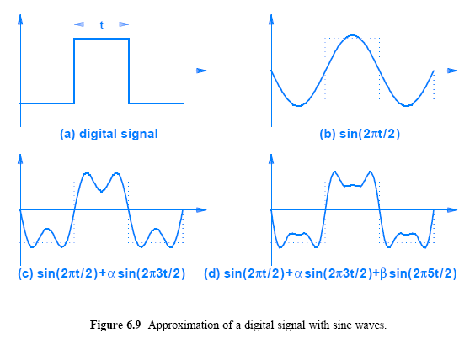
Converting a Digital Signal to Analog
Notes:
19

Slide 20
Synchronization and Agreement About Signals
The electronics at both ends of a physical medium must have circuitry to measure time precisely
Building electronic systems that agree at the high speeds used in modern networks is extremely difficult
A fundamental problem: synchronization of sender/receiver
Missing a bit creates misinterpretation
Notes:
20

Slide 21
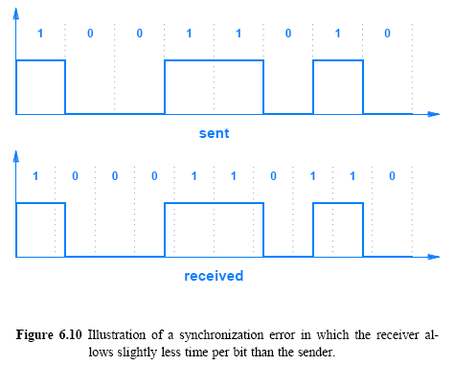
Synchronization and Agreement About Signals
Notes:
21

Slide 22
Line Coding
How to avoid synchronization errors:
Uses a known pattern of bits before the transmission - typically a set of alternating 0s and 1s, for receiver to synchronize
Systematic data representation to avoid confusion about the meaning
line coding: the way data is encoded in a signal
Notes:
22

Slide 23
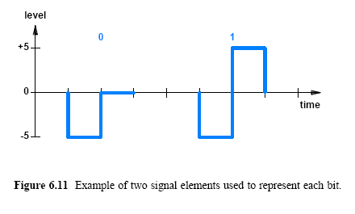
Line Coding
Notes:
23

Slide 24
Line Coding
Multiple signal elements for a single bit means fewer bits can be transmitted per unit time
Would like to transmit multiple bits per signal element
A variety of line coding techniques are available that differ in
how they handle synchronization
the bandwidth used
Notes:
24

Slide 25
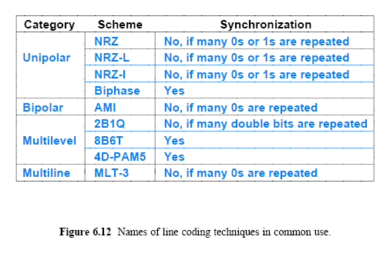
Line Coding
Notes:
25

Slide 26
Manchester Encoding
Manchester Encoding used with Ethernet
Detect a transition in signal level
Detecting transition is easier than measuring signal level
1 corresponds to a transition from negative voltage level to a positive voltage level and vice versa
Notes:
26

Slide 27
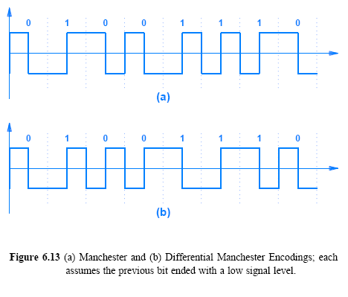
Manchester Encoding Used in Computer Networks
Logical zero
Represented by a transition
Logical one
Represented by no transition
Notes:
27

Slide 28
Differential Manchester Encoding
Relative transitions
Depends on the previous bit
Always a transition in middle of interval
0 = transition at beginning of interval
1 = no transition at beginning of interval
The encoding works correctly even if the two wires carrying signal are reversed
Notes:
28

Slide 29
Converting an Analog Signal to Digital
Analog signals must be converted to digital form
Two basic approaches:
Pulse code modulation (PCM)
Delta modulation (DM)
In PCM, the level of an analog signal is measured repeatedly at fixed time intervals and converted to digital form
Notes:
29

Slide 30
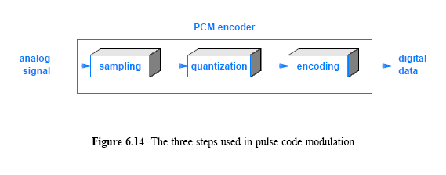
Converting an Analog Signal to Digital
Notes:
30

Slide 31
Converting an Analog Signal to Digital
The three steps used PCM
First stage is known as sampling
each measurement is known as a sample
A sample is quantized
a small integer value
not a measure of voltage or any other property of the signal
the range of the signal from the minimum to maximum levels is divided into a set of slots, typically a power of 2
Then encoded into a specific format
Notes:
31

Slide 32
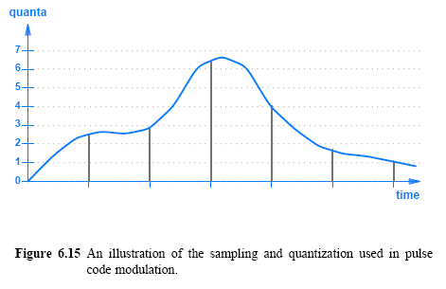
Converting an Analog Signal to Digital
Notes:
32

Slide 33
Converting an Analog Signal to Digital
Delta modulation (DM)
DM sends one quantization value followed by a string of values (differences)
Requires fewer bits
The main tradeoff with DM is the effect of an error
Any missing or damaged item cause misinterpretation
Notes:
33

Slide 34
The Nyquist Theorem and Sampling Rate
Sampled in PCM or DM
Undersampling
Oversampling
Proper sampling is given by Nyquist theorem:
where f_{max} is the highest frequency in the composite signal
Notes:
34

Slide 35
Nyquist Theorem and Telephone System Transmission
Frequencies between 0 - 4000 Hz considered acceptable audio quality for human
Sampling rate of 8000 samples per second
The PCM standard quantifies each voice sample into an 8 bit value for quality
The rate generated for a single telephone call is:
Notes:
35

Slide 36
VoIP
Area code irrelevant
One number multiple devices
Any device
ENUM (an IETF standard – RFC 2916)
Translates telephone numbers (E164 numbers) into internet addresses (DNS)
SIP/ H.323 VoIP addresses
IP FAX servers
Voice Mail Servers
Email addresses
PSTN services (redirect)
PSTN used as the inter-VoIP network

Slide 37
Encoding and Data Compression
Data compression reduces the number of bits required to represent data
Data compression
reduces transmission time
a communication system can be optimized
There are two types of compression:
Lossy
Lossless
Notes:
37

Slide 38
Encoding and Data Compression
Lossy compression
Some information is lost, e.g., images, video/audio
Preserve details to the level of human perception
JPEG (used for images) compression or MPEG-3 (abbreviated MP3 and used for audio recordings)
Lossless compression
preserves the original data without change
Forms a dictionary for repeated strings (keeps reference to the string in the dictionary)
Sender must send dictionary with compressed data
Notes:
38

